Slide 1

Reading wafer maps
automatically
SCTP MODULE 3 · MACHINE LEARNING PROJECT
Teaching a computer to spot defect patterns on silicon wafers, so chip factories fix faulty machines faster
Eric Seow · Nov 2026
Notes:
[0:00–0:15 · 15 s] Good morning, everyone. I’m Eric. Every wafer that leaves a chip factory carries a kind of fingerprint of what went wrong while it was being made. My project teaches a computer to read that fingerprint.

Slide 2
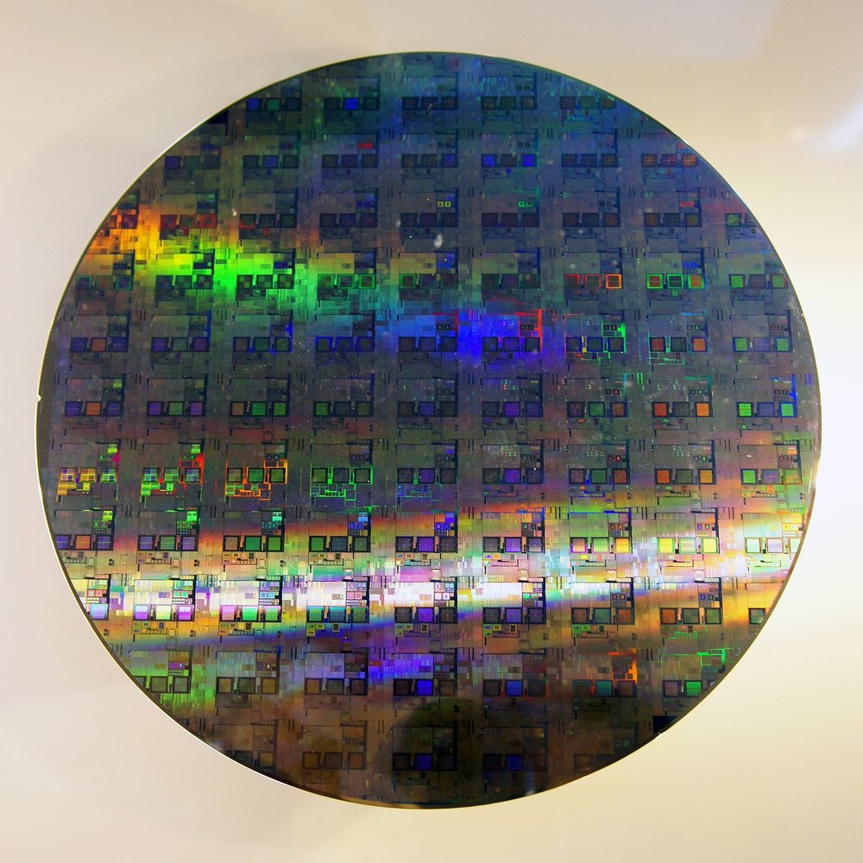
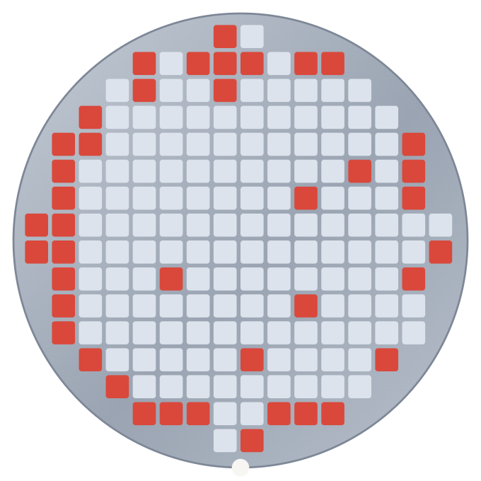

From silicon disc to wafer map
CHIPS 101
Left: a real 12-inch (300 mm) wafer. Right: its wafer map, where each square is a chip and red means it failed.
Think of a baking tray
If only the cookies at the edge are burnt, you check the oven, not the recipe. Where chips fail tells engineers which machine to check.
01
02
03
04
A wafer
Hundreds of steps
Final test
Wafer map
A silicon disc carrying hundreds of chips
Machines build layers over several weeks
Every chip is tested: works or fails
Results plotted by chip position
Photo: Peellden, CC BY-SA 3.0, via Wikimedia Commons (resized) · Wafer map: illustration
Notes:
[0:15–1:05 · 50 s] Before we start, a quick primer, in case you’ve never worked with chips. On the left is a real wafer. It’s a silicon disc about the size of a dinner plate, with hundreds of chips on it. It goes through hundreds of machine steps over several weeks, and at the very end, every chip gets tested. It either works or it doesn’t. If you plot those results by position, you get a wafer map, like the one on the right. Each square is a chip, and the red ones failed. See how they form a ring around the edge? Think of a baking tray: if only the cookies at the edge are burnt, you’d check the oven, not the recipe. It’s the same idea here.

Slide 3
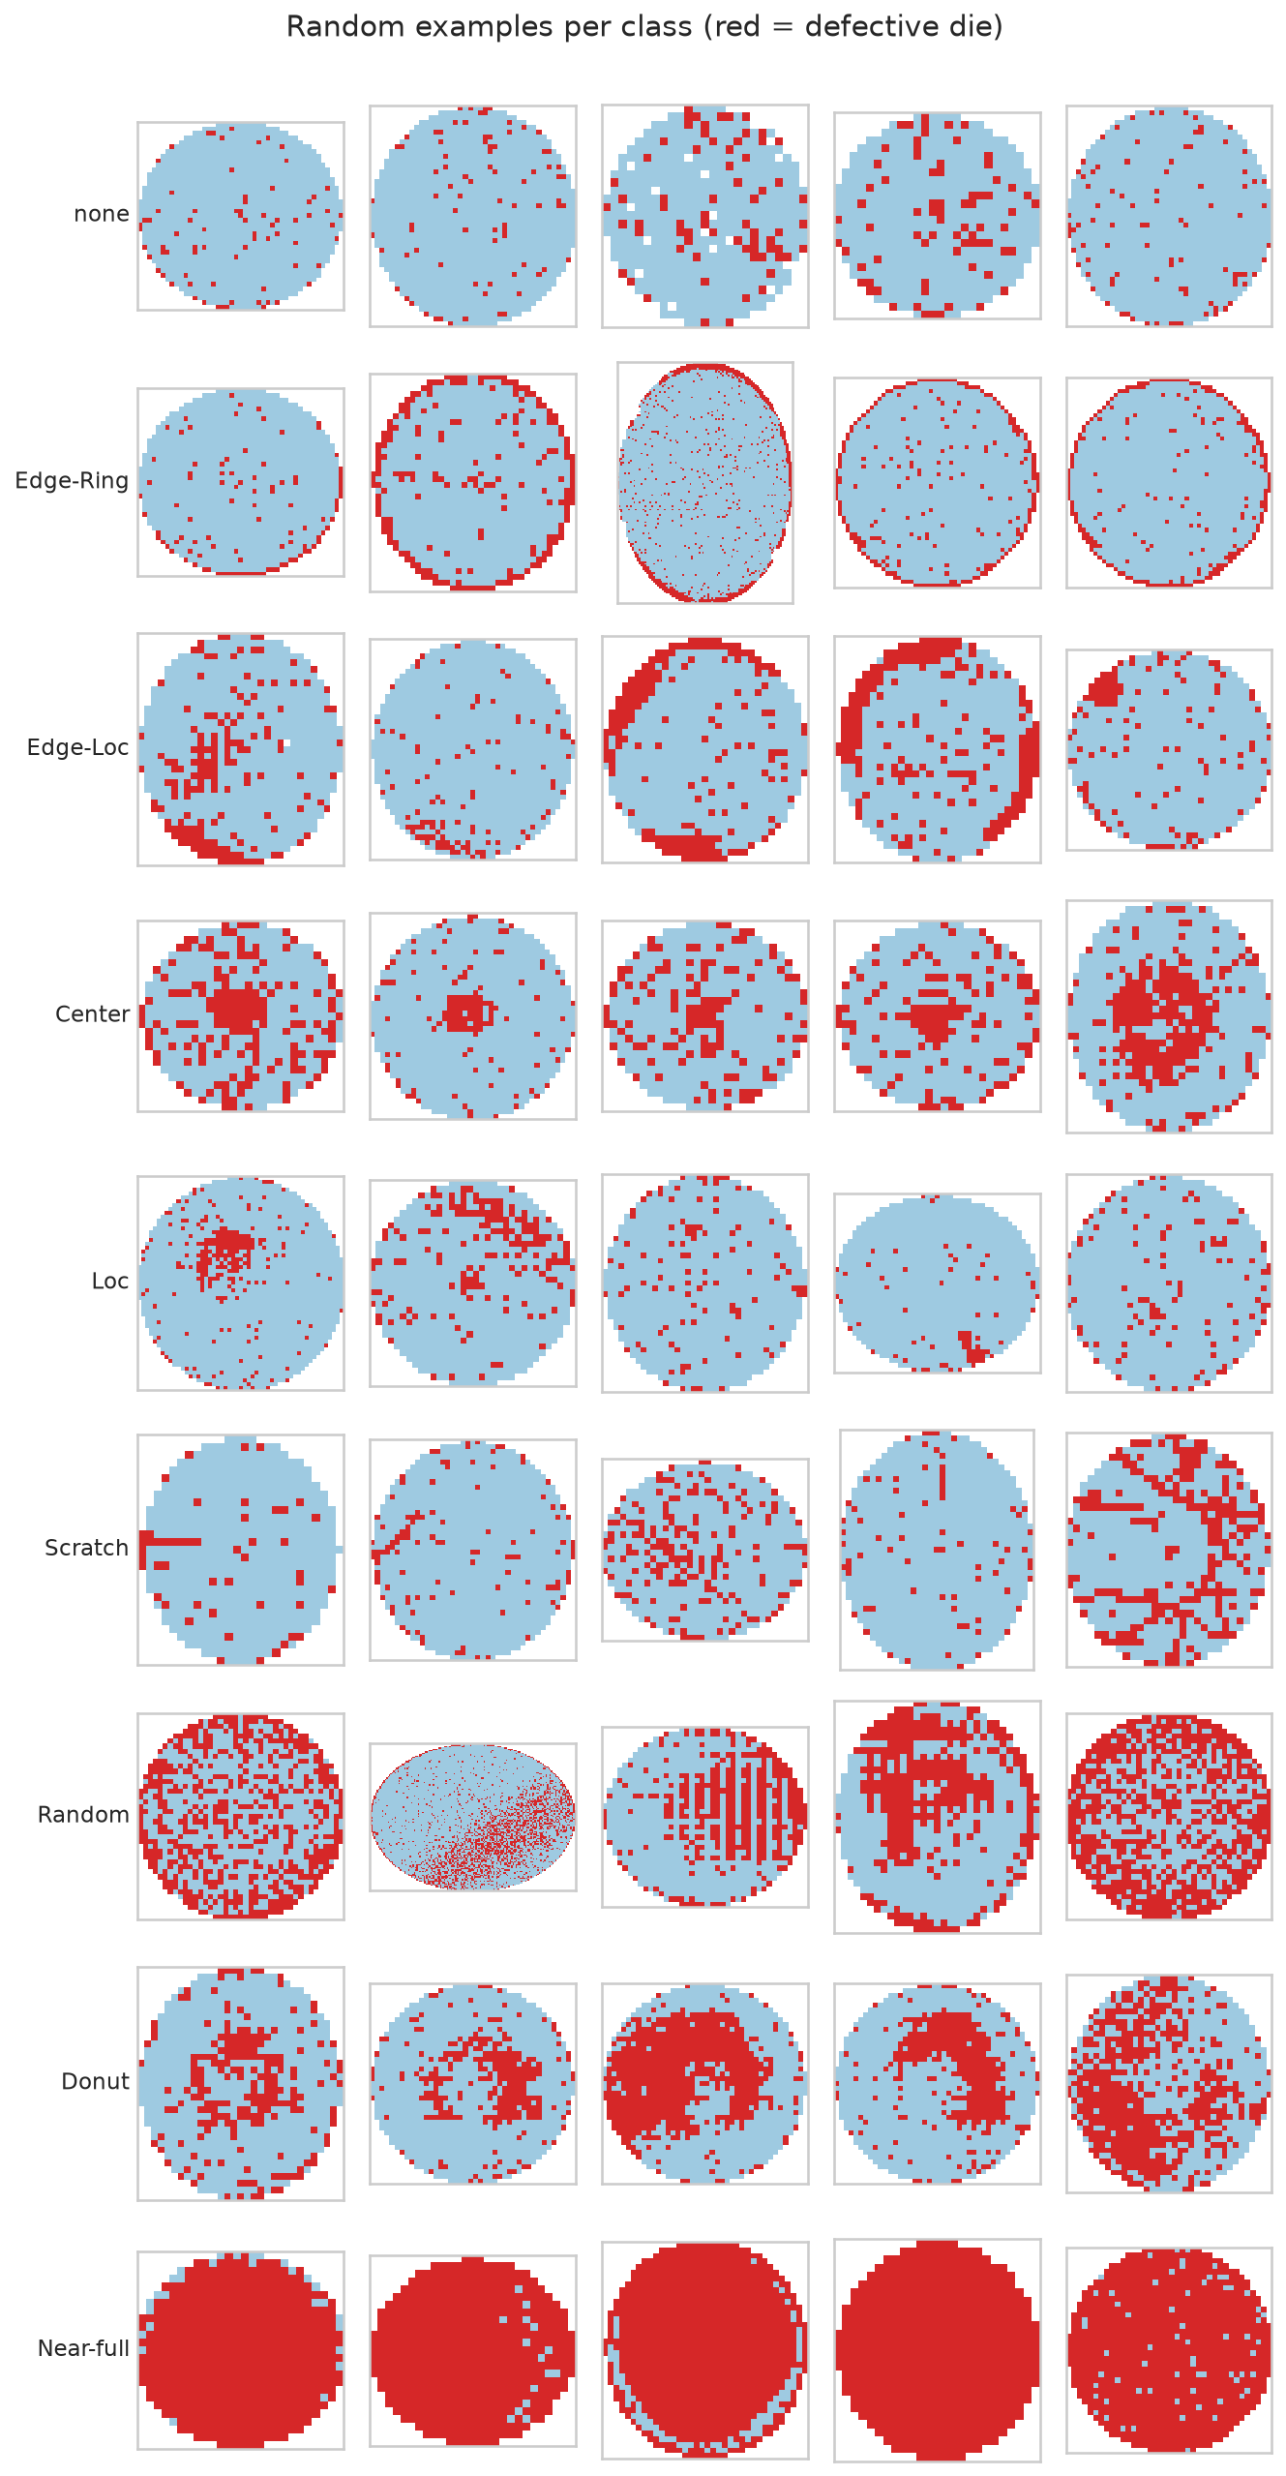
A faulty machine can ruin many wafers
THE BUSINESS PROBLEM
Each wafer is worth $1,000–1,500. A faulty machine can damage many before anyone notices.
The pattern of failed chips points to the machine at fault: a ring at the edge, a scratch, a blob in the centre.
Engineers read the maps by eye. At ~50,000 wafers a month, most are never looked at.
Goal: read every map automatically and alert the right team sooner.
Right: real wafer maps, 5 per pattern (red = failed chip)
Notes:
[1:05–2:00 · 55 s] So why does this matter? One wafer is worth about a thousand to fifteen hundred dollars. If a machine goes wrong, it keeps damaging wafers until someone notices, and that adds up fast. The good news is that the pattern of failed chips tells you where to look. A ring at the edge, a scratch, a blob in the middle: each one points to a different problem. You can see real examples on the right. The trouble is, engineers read these maps by eye. It’s slow, subjective, and when you’re making around fifty thousand wafers a month, most maps never get looked at. So my goal was simple: read every map automatically, and tell the right team sooner.

Slide 4
The model sorts each map into 9 patterns
TYPE OF ML PROBLEM
Question | Answer | Why
Learns from | Labelled examples (supervised) | Engineers labelled 173k maps
Output | 9 classes | 8 defect patterns + “no pattern”
When it runs | In batches | After each batch of wafers is tested
Time series? | No | Each map is judged on its own
Checks during production
Final chip test
This model
Catch most problems and stop the machine
Some problems only show up here
Reads every test map and alerts the right team
Notes:
[2:00–2:40 · 40 s] In machine learning terms, this is supervised classification. Supervised, because the model learns from about 173 thousand maps that engineers have already labelled. Classification, because the answer is a name: one of eight defect patterns, or no pattern at all. It runs in batches, after each set of wafers is tested. One thing to remember for later: the checks during production already catch most problems. This model is a safety net for the ones that only show up at the final test.

Slide 5
811,457 real wafer maps, 21% of them labelled
DATASET
811,457
172,950
46,293
9
wafer maps
labelled, used here
production lots
pattern classes
Known limitations
85% of labelled maps are “none”; the rarest class has only 149 maps
No timestamps, so drift over time cannot be tested
Labels were assigned by people and some look wrong
Anonymised fab, data published in 2015: the model must be retrained on a new fab’s data
Source: Wu, Jang & Chen (2015), IEEE Trans. Semiconductor Manufacturing · WM-811K on Kaggle
Notes:
[2:40–3:20 · 40 s] The data is a public dataset called WM-811K: about 811 thousand real wafer maps from a chip factory, published in 2015. Only around a fifth of them have labels, so those 173 thousand are what I used. There are some known limitations of the dataset. The classes are very uneven, there are no timestamps, some labels look wrong, and we don’t know which factory it came from. So before any real use, I would retrain it on that factory’s own data.

Slide 6
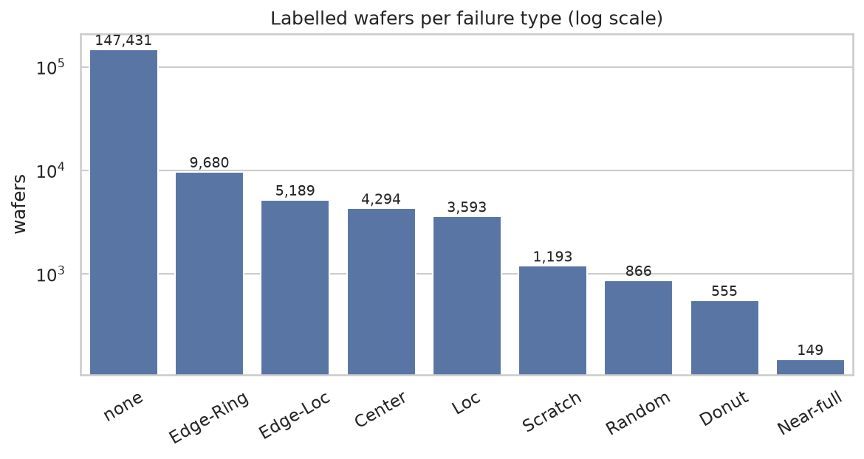
Defects are rare, so accuracy misleads
EDA INSIGHT 1
85%
accuracy for a model that always says “none” and catches zero defects
So we
judge models on macro-F1
weight rare classes in training
keep class shares equal in every split
Notes:
[3:20–4:00 · 40 s] Here’s the first big thing I found. 85 percent of the maps have no defect at all, and the rarest pattern has just 149 examples. That’s on a log scale, so the gap is even bigger than it looks. It means a useless model that always says “no defect” gets 85 percent accuracy and catches nothing. So accuracy is the wrong measure here. I used macro-F1 instead, which scores all nine patterns equally, so rare defects count just as much. I also gave the rare patterns more weight in training.

Slide 7
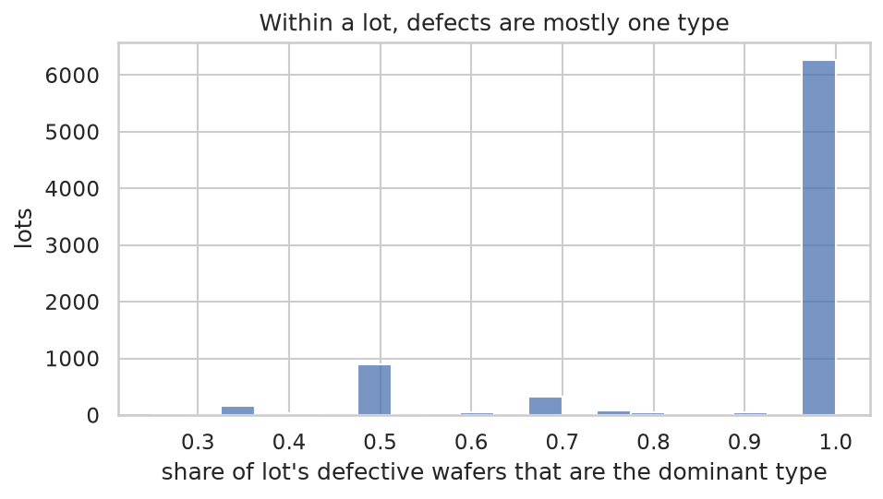
Defects cluster by lot, so we split by lot
EDA INSIGHT 2
About 90% of a lot’s defective wafers share one type. A random split leaks near-duplicates into the test set.
→ Split and cross-validate by lot
→ Own 80/20 split: 0 shared lots, every class 80/20
Notes:
[4:00–4:35 · 35 s] Another finding changed how I tested the model. Wafers are made in batches called lots with 25 wafers, and inside a lot, about 90 percent of the defective wafers share the same pattern. That makes sense, since they went through the same machines. But it’s a trap. If wafers from one lot end up in both training and testing, the model has basically seen the answers, and the score looks better than it really is. So I made my own 80/20 split that keeps whole lots together.

Slide 8
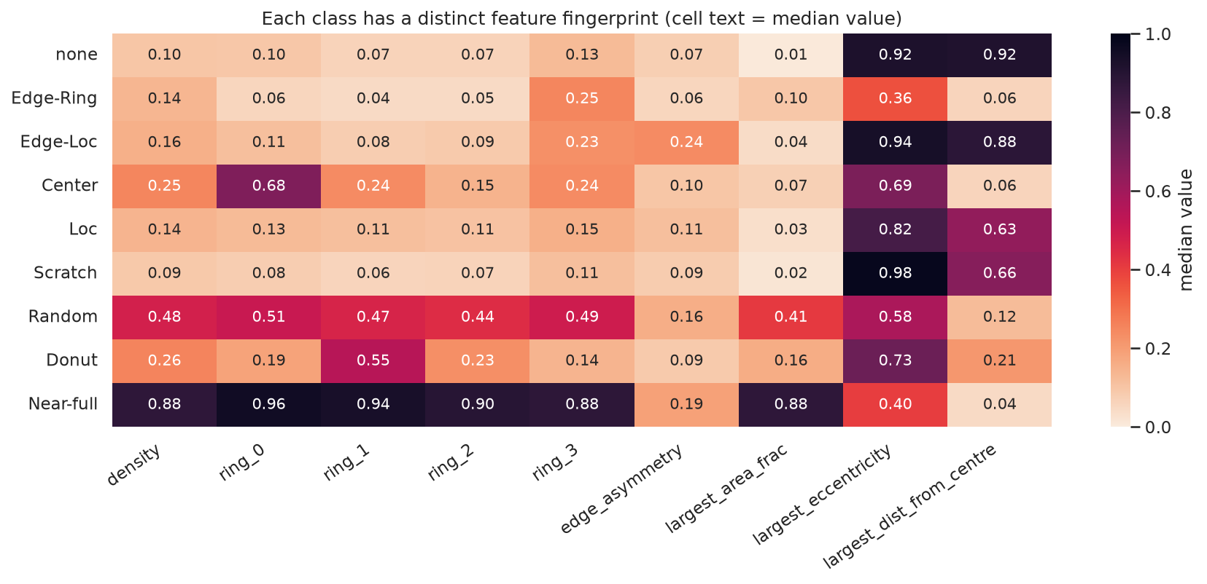
Each wafer map becomes 69 numbers
FEATURE ENGINEERING
Group | # | Catches
Cluster shape | 9 | Scratch, Center
Radon lines | 40 | Lines vs rings
Rings | 4 | Center, Donut
Edge quadrants | 5 | Edge-Ring vs Edge-Loc
3×3 grid | 9 | Where a blob sits
Global | 2 | Near-full, Random
Each class has its own fingerprint, e.g. Center: dense centre ring (0.68); Edge-Loc: one-sided edge (asymmetry 0.24).
All features are ratios or normalised positions, so maps of 346 different sizes are comparable
Notes:
[4:35–5:25 · 50 s] Here’s a practical problem. Wafer maps come in 346 different sizes, but these models need the same columns for every wafer. So I turned each map into 69 numbers that describe where the failures are and what shape they make. How dense are they from the centre out to the edge? Is the edge hit evenly, or just on one side? Are there straight lines? What does the biggest cluster look like? The heatmap shows it works: each pattern has its own fingerprint. Centre defects light up the centre ring, for example. The shape of the biggest cluster turned out to matter most, driving about half of the model’s decisions.

Slide 9
Each step up in complexity paid off
MODELS TRIED
Model | Macro-F1 | Defect recall | Defect precision | Accuracy
Baseline: always “none” | 0.102 | 0% | – | 85.2%
Logistic regression | 0.756 | 98.6% | 68.8% | 92.1%
Random Forest | 0.868 | 88.2% | 97.5% | 97.3%
Gradient Boosting | 0.894 | 96.5% | 92.5% | 97.7%
Gradient Boosting, tuned (final) | 0.896 | 95.1% | 94.8% | 97.9%
Defect recall = share of real defect wafers flagged. Precision = share of flags that are real.
5-fold cross-validation grouped by lot, training set only; the same folds for every model
Notes:
[5:25–6:25 · 60 s] Next, I compared models, starting simple and getting more complex. They were all tested the same way, with five-fold cross-validation. Two terms to know: defect recall is how many real defects we catch, and precision is how many of our alarms are real. The baseline gets 85 percent accuracy and catches nothing, as we saw. Logistic regression catches almost every defect, but nearly a third of its alarms are false. Random Forest is the opposite: its alarms are very reliable, but it misses more. Gradient boosting is the optimal from these 3 models where it has acceptable recall and precision. Therefore, tuning was done on this model and it helped a little. The final model catches 95 percent of defects, and 95 percent of its alarms are real.

Slide 10
Results hold on lots the model never saw
EVALUATION ON THE SEALED TEST SET
0.901
95.5%
macro-F1 (validation 0.896, baseline 0.102)
defect recall (validation 95.1%; 232 of 5,105 missed)
94.7%
14.9%
defect precision (validation 94.8%); the type is right 96% of the time
of wafers flagged as a defect; the other 85% need no action
2.9% of wafers fall below 0.90 confidence and go to an engineer; 97.1% route automatically
Test set: 34,585 wafers from 2,161 lots, used once after the model was chosen
Notes:
[6:25–7:20 · 55 s] Now for the test set evaluation. I locked away a test set at the very start: about 35k wafers from lots the model had never seen, and I used it exactly once. It scored 0.901 macro-F1, almost the same as in validation, so the earlier estimate was honest. The baseline was just 0.102. Defect recall is 95.5 percent, so it catches almost all the defect wafers. Defect precision is 94.7 percent, so nearly all its alarms are real. And when it flags a real defect, it names the right pattern 96 percent of the time. Out of all the wafers, it points you to the 15 percent worth looking at. And when it isn’t sure, which is 2.9 percent of wafers, it hands them to an engineer.

Slide 11
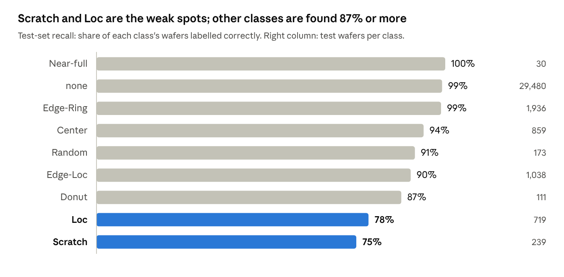
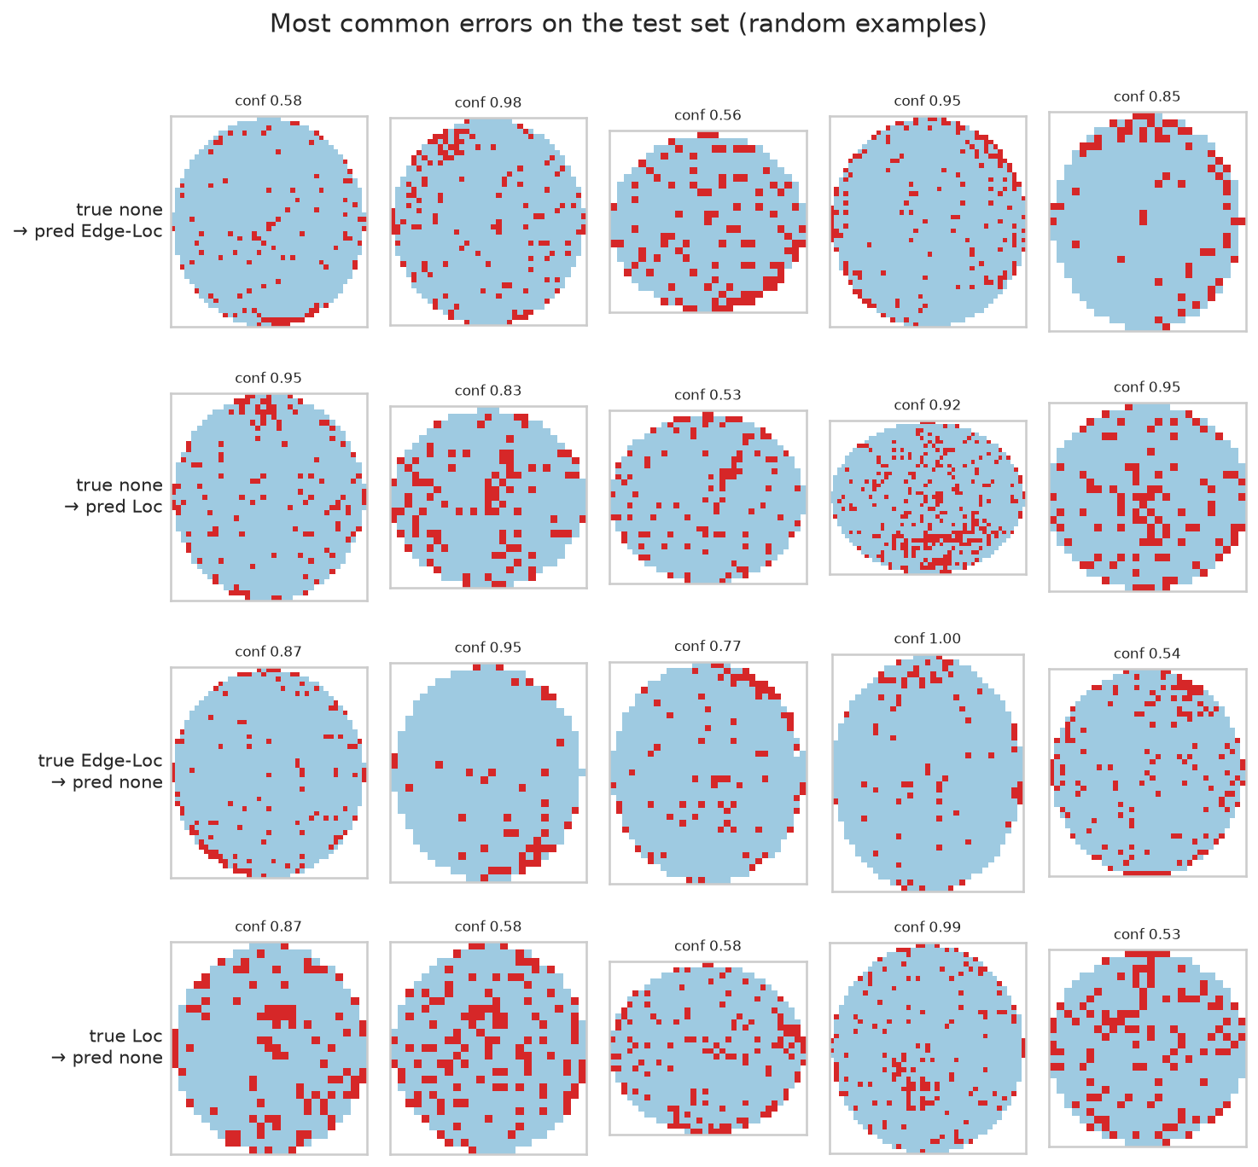
Scratch and Loc are the weak spots
ERROR ANALYSIS
Most misses are faint, sparse maps called “none”; some look mislabelled. Weakest on medium-sized wafers (defect recall 91.8%).
Notes:
[7:20–8:10 · 50 s] So where does it go wrong? On the left is how often each pattern gets found. Most are above 90 percent. The weak spots are scratches, at 75 percent, and small local blobs, at 78. They only involve a few chips, so they get lost among random failures, and the model usually calls them no pattern. On the right are real mistakes. Honestly, a lot of these are hard to call even by eye, and some look mislabelled, so part of the problem is the labels, not just the model.

Slide 12
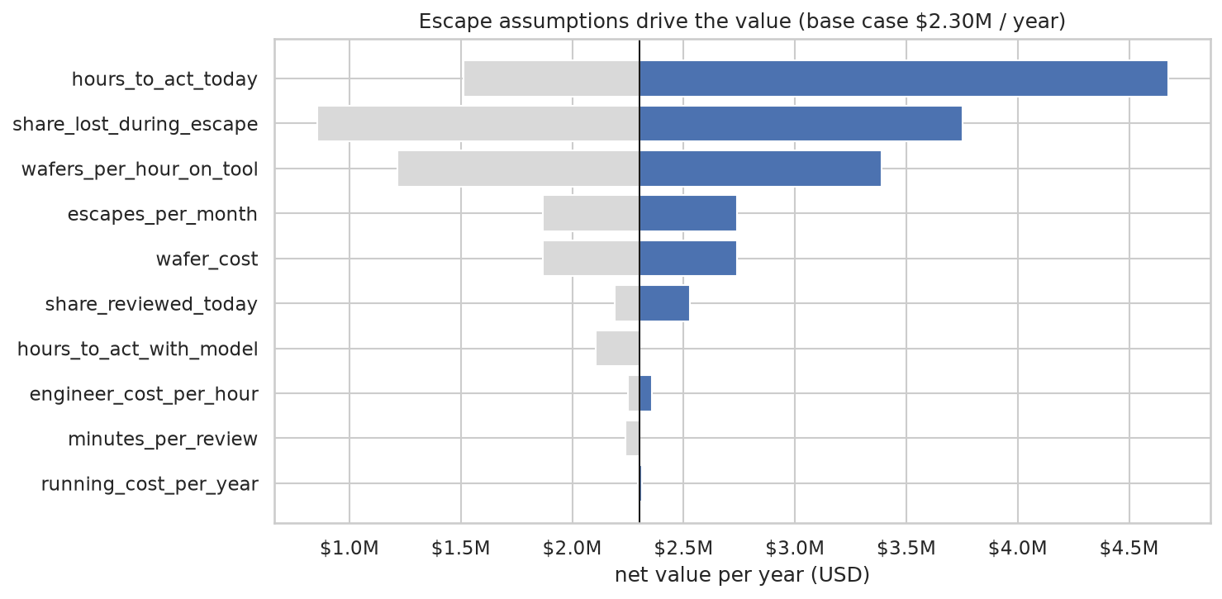
Worth about $2.3M a year in the base case
OPPORTUNITY SIZING (PROVISIONAL)
USD per year | Pessimistic | Base | Optimistic
Review time saved | $19k | $160k | $514k
Escape losses avoided | $126k | $2.17M | $16.4M
Net, after running cost | $106k | $2.30M | $16.9M
Payback of build cost | 14 months | 2 weeks | days
About 93% of the value comes from acting sooner on escapes: problems inline inspection misses (CMP scratches, edge clusters, edge rings).
Biggest unknowns: hours to act today, wafers lost per escape, tool throughput.
Assumptions: 50,000 wafers a month · 2–3 escapes a month · $1,000–1,500 per wafer · 8–24 h to act today (fab experience + estimates)
Notes:
[8:10–9:25 · 75 s] So what’s it worth? I sized this for a factory making 50 thousand wafers a month. These are estimates based on fab experience, so treat them as provisional. The value comes from two places. The smaller one is time: engineers review far fewer maps, worth about 160 thousand dollars a year. The bigger one is what I call escapes. These are problems that slip past the checks during production, like polishing scratches and edge rings, and only show up at the final test. Today it can take 8 to 24 hours before anyone acts on one. With the model, it’s about an hour, so fewer wafers get ruined. That’s around 93 percent of the value. In the base case, that’s about 2.3 million dollars a year after running costs, and it pays for itself within two weeks. Even in the pessimistic case, it pays back in about 14 months. The chart on the right shows which assumptions matter most, and those are what a pilot should measure.

Slide 13
Known risks, each with a mitigation
RISKS AND LIMITATIONS
Risk | Mitigation
Scratch recall only 74.5% | Manual review on CMP-heavy products; improve Scratch first
Trained on another fab’s data (published 2015) | Retrain on this fab’s maps before the pilot
Patterns outside the 9 classes | Low confidence routes to engineers; track that share
Over-trust in the model | Weekly audit of auto-routed wafers
Regulatory risk is low: internal process data, no personal information. Maps are process IP, so the model runs inside the fab network.
Notes:
[9:25–10:00 · 35 s] Of course, there are risks, and each one has a fix. The biggest is scratches, since that’s the weakest pattern, so those products keep manual review until it improves. The model also has to be retrained on the new factory’s data. If a brand-new pattern turns up, the model won’t be confident, so it goes to a person. And a weekly audit stops anyone trusting it blindly.

Slide 14
Every wafer map read, the uncertain 3% sent to people
SUMMARY
Next: retrain on the fab’s own maps, improve Scratch detection, and run the 3-month pilot.
Questions?
Notes:
[10:00–10:20 · 20 s] So, to wrap up: every wafer map gets read, and only the uncertain 3 percent go to people.
About 4½ minutes spare: slow down on the results and value slides. Q&A prep Why no CNN? Time; it is the natural next step, especially for scratches. Value numbers? Fab experience plus estimates; provisional. New defect types? Low confidence, so they go to engineers. Why macro-F1? Accuracy rewards ignoring defects. How did you tune? 25 random settings, then a 3×3 grid search with lot-grouped CV. Regularisation mattered most; good settings tied, so I kept the one catching most defects. Why your own split? The dataset’s split is skewed: 12% of Edge-Ring in its test half vs 75% of “none”. Leakage? Appendix B. Exact confusions? Appendix A. Why 0.90? Auto-routes 97.1% at 0.945 macro-F1; no industry standard, it is a cost trade-off. Deployment? Batch scoring after test; confident defects alert the team, uncertain wafers go to engineers, their labels feed monthly retraining; A/B test on hours to act. Expand the pilot when? Hours to act halve, missed escapes do not rise, overrides stay under 10%.

Slide 15
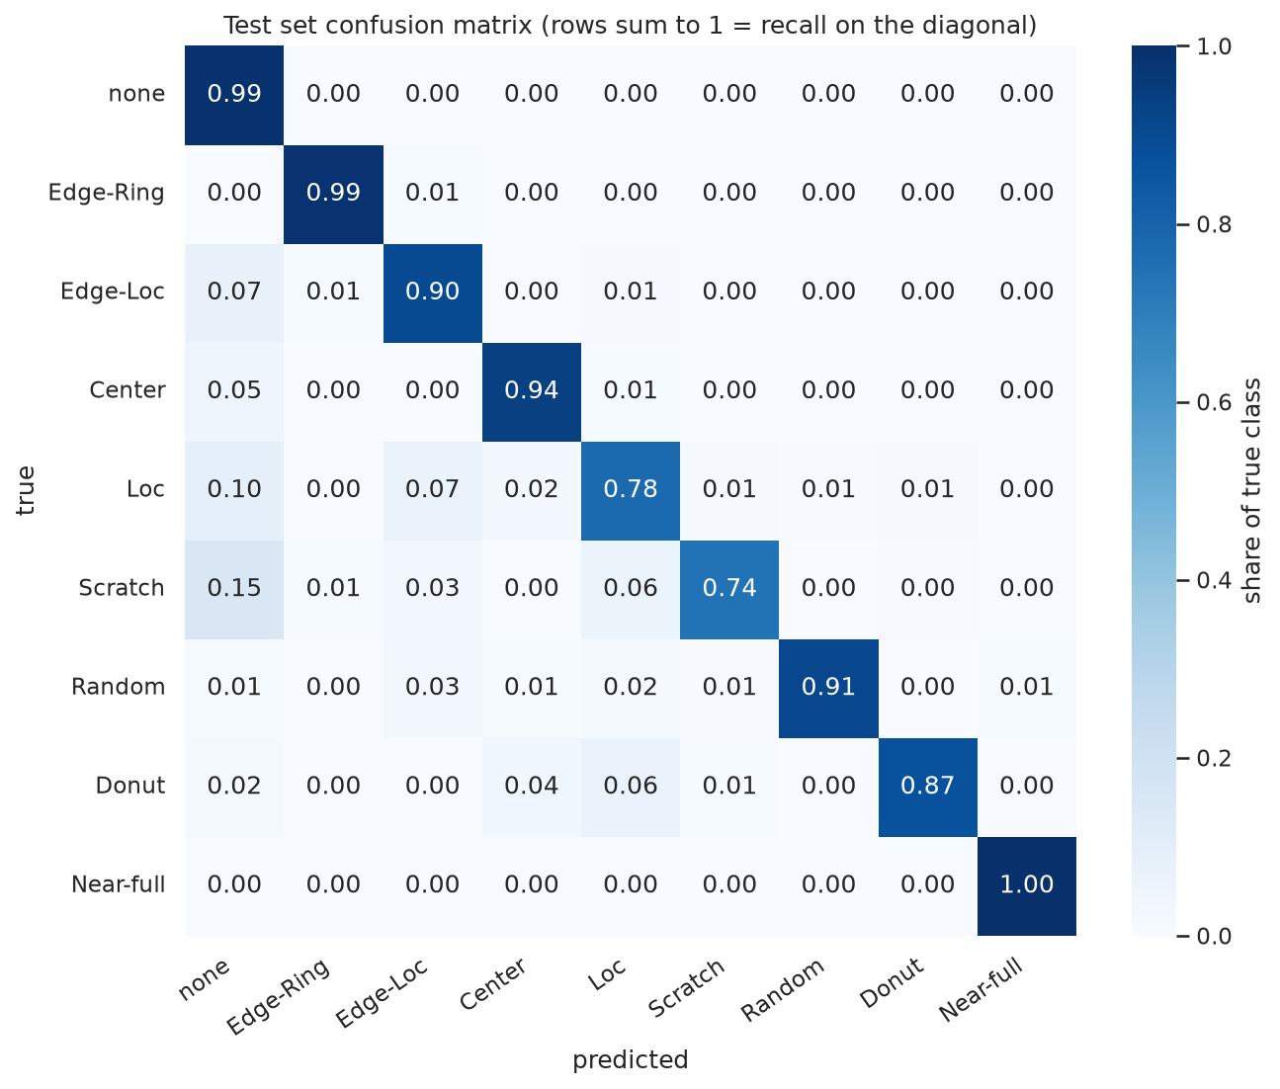
Most errors sit between “none” and faint patterns
APPENDIX A · TEST CONFUSION MATRIX
Most common mistakes (test wafers)
True | Predicted | Wafers
none | Edge-Loc | 105
none | Loc | 95
Edge-Loc | none | 75
Loc | none | 69
Loc | Edge-Loc | 50
Rows sum to 1, so the diagonal is recall per class.
Notes:
Q&A only, not part of the 15 minutes. Mistakes go both ways: 271 normal wafers were flagged as a defect and 232 defect wafers were passed as no pattern. The confusions are between similar-looking patterns: faint local blobs versus normal wafers, and local blobs near the edge versus edge-local defects.

Slide 16
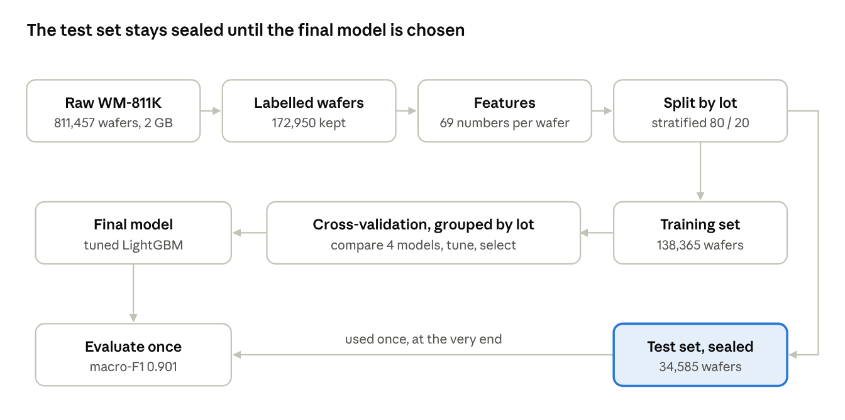
How the test score stayed honest
APPENDIX B · LEAKAGE CONTROLS
Split by lot: no lot in both sets
Cross-validation grouped by lot too
Features use one wafer’s own map only
Scaling fitted inside each training fold
Class weights on training data only
Test set used once, after choosing
Notes:
Q&A only, not part of the 15 minutes. Every step that learns from data sees only the training lots. The close match between validation (0.896) and test (0.901) is the evidence that nothing leaked.

